Slide 1

Python Functions
Dr. Francis Jesmar P. Montalbo
Week 4

Slide 2
OUTLINE
User-defined Functions
Built-in Functions
Lambda Functions
Higher-order Functions

Slide 3
USER-DEFINED FUNCTIONS

Slide 4
What are User-defined Functions?
A way to organize and reuse code.
Creates a block of code once and use it multiple times in your program.
Defined using the "def" keyword, and they can take in parameters and return values.

Slide 5
Example
Here's an example of a simple function that takes in two numbers and returns their sum:
def add(num1, num2):
return num1 + num2
result = add(55, 6)
print(result) # prints 61

Slide 6
Explanation
In the example, the function "add" takes in two parameters, “num1" and “num2", and returns the sum of those two numbers. We then call the function by passing in the values 55 and 6 as the arguments, and the function returns 61 which is the sum of 55 and 6.

Slide 7
Example
Functions can also have default values for their parameters, which means that if a value for that parameter is not provided when the function is called, the default value will be used instead. For example:
def add(a, b=0):
return a + b
result = add(3)
print(result) # prints 3
result = add(3,4)
print(result) # prints 7

Slide 8
Explanation
In the example, the function "add" takes in two parameters, "a" and "b", with a default value of 0 for b. When we call the function with one argument, the default value of b is used.

Slide 9
Function Scope
Another important concept related to functions is the idea of a "scope". Variables defined inside a function are only accessible within that function and are not available outside of it.
def my_function():
x = 5
print(x)
my_function() # prints 5
print(x) # raises an error

Slide 10
Explanation
In the example, the variable "x" is defined inside the function "my_function" and is only accessible within that function. Attempting to access it outside of the function will raise an error.

Slide 11
Example
Functions can also be used as arguments to other functions. This is called "callback" function, when a function is passed as an argument to another function.
def square(x):
return x*x
def cube(x):
return x*x*x
def apply(func, x):
return func(x)
print(apply(square, 3)) # prints 9
print(apply(cube, 3)) # prints 27

Slide 12
Explanation
In the example, we have two functions "square" and "cube", which take a number and return its square or cube respectively. We also have a function "apply" which takes two arguments, first is a function and second is a number, it applies that function on that number.

Slide 13
Arguments
Values passed to a function when it is called. These values are then assigned to the function's parameters, which are the names used within the function to refer to the received values.
Types of Arguments:
Positional Arguments
Keyword Arguments
Variable-length Arguments

Slide 14
Positional Arguments
In this example, the function "my_function" takes three positional arguments "a", "b", and "c". When we call the function with the values 1, 2, and 3, the function adds them together and returns the result, which is 6.
def my_function(a, b, c):
return a + b + c
result = my_function(1, 2, 3)
print(result) # 6

Slide 15
Keyword arguments
In this example, the function "my_function" takes three keyword arguments "a", "b", and "c". When we call the function with the keyword arguments c=1, a=2, and b=3, the function adds them together and returns the result, which is 6.
def my_function(a, b, c):
return a + b + c
result = my_function(c=1, a=2, b=3)
print(result) # 6

Slide 16
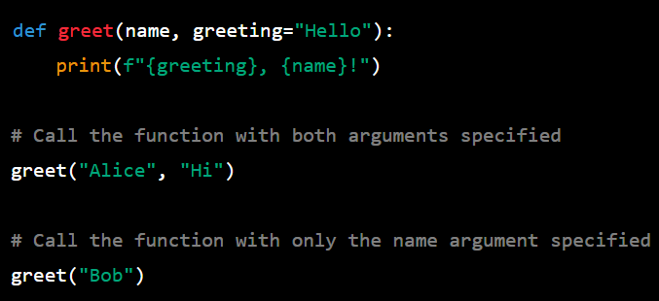


DEFAULT VALUE ARGUMENT
In Python, you can define a function with default values for its arguments. This means that if the user doesn't supply a value for a particular argument when calling the function, it will automatically be set to the default value specified in the function definition.

Slide 17
Variable-length Arguments
In this example, the function "my_function" takes a variable-length tuple of arguments "*args". When we call the function with the values 1, 2, 3, 4, and 5, the function adds them together using the built-in "sum" function and returns the result, which is 15.
def my_function(*args):
return sum(args)
result = my_function(1, 2, 3, 4, 5)
print(result) # 15

Slide 18
*args and **kwargs
*args and **kwargs are used as arguments if there is doubt in the number arguments to be passed in a function.
It is worth noting that is the “*” (args) and “**” (kwargs) rather than args or kwargs.
In general, *args and **kwargs are most useful when you don't know in advance how many arguments or keyword arguments you need to pass to a function, or when you want to make your code more flexible.
They are particularly useful when you are writing functions that work with different types of data, or when you are writing functions that need to be reused in different contexts.

Slide 19
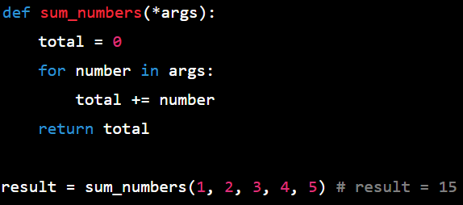
*Args
Use *args when you need to accept an arbitrary number of non-keyword arguments. This is useful when you don't know in advance how many arguments you need to pass to a function, or when you want to make your code more flexible. For example, if you are writing a function that computes the sum of a list of numbers, you could use *args to allow the function to accept any number of arguments:
When *args is used in a function definition, any non-keyword arguments passed to the function are collected into a TUPLE.

Slide 20
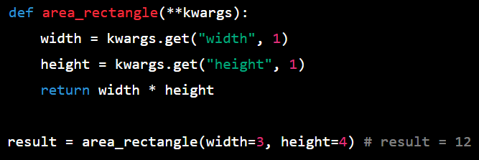
**Kwargs
Use **kwargs when you need to accept an arbitrary number of keyword arguments. This is useful when you want to provide default values for some of the arguments, or when you want to make your code more flexible. For example, if you are writing a function that computes the area of a rectangle, you could use **kwargs to allow the function to accept any combination of width and height, and to provide default values for width and height if they are not provided:
`1` in this example is the default value for ‘width’ and ‘height’
When **kwargs is used in a function definition, any keyword arguments passed to the function are collected into a DICTIONARY.

Slide 21
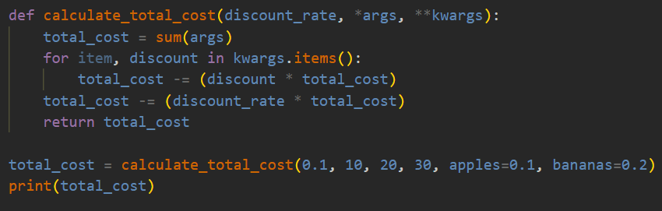

Using both *args and **Kwargs
Use *args and **kwargs together when you need to accept both non-keyword and keyword arguments. This is useful when you want to provide maximum flexibility for your function. For example, if you are writing a function that computes the sum of a list of numbers, and you want to allow the user to provide an optional starting value, you could use both *args and **kwargs:

Slide 22
Built-In FUNCTIONS

Slide 23
Built-in Functions
A pre-defined function that is available in the global namespace of the interpreter. These functions are always available to use in any Python program without the need for any additional imports or installations.
map()
filter()
reduce()
sorted()

Slide 24

Map()
Executes a specified function for each item in an iterable. The item is sent to the function as a parameter.
Such elements of an iterable include a list, tuple, or string and returns a new iterable object with the results.
This built-in function allows you to process and transform all the items in an iterable without using an explicit for loop
function is a function that takes one argument and returns a value.
iterable is an iterable object that contains the values to be processed by the function.

Slide 25
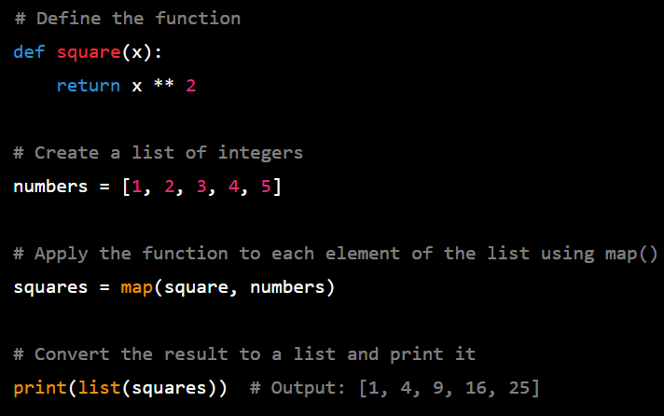
Map() Example
Here's an example of using map() to convert a list of integers to a list of their squares:
In this example, map() applies the square() function to each element of the numbers list and returns a new iterable containing the squares of the original values.
The list() function is used to convert the resulting iterable to a list so that it can be printed.

Slide 26

FILTER()
Filters the elements of an iterable based on a given function and returns an iterator containing only the elements for which the function returns True.
function is a function that takes one argument and returns a boolean value (True or False).
This built-in function allows you to process an iterable and extract those items that satisfy a given condition
iterable is an iterable object that contains the values to be filtered.

Slide 27
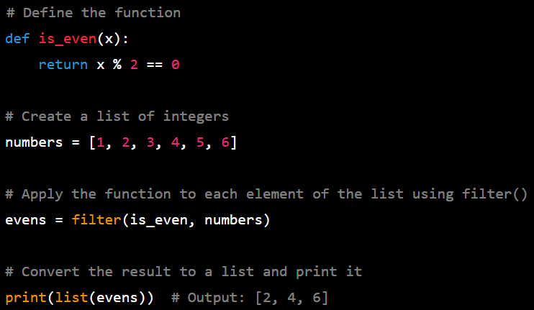
FILTER() Example
Here's an example of using filter() to keep only the even numbers in a list of integers:
In this example, filter() applies the is_even() function to each element of the numbers list and returns an iterator containing only the even numbers.
The list() function is used to convert the resulting iterator to a list so that it can be printed.

Slide 28


REDUCE()
Applies a given function to the elements of an iterable in a cumulative way and returns a single value that represents the "reduced" result of the operation.
function is a function that takes two arguments and returns a value.
iterable is an iterable object that contains the values to be reduced.
initial is an optional initial value to start the accumulation. If not provided, the first element of the iterable is used as the initial value.
In Python 2, reduce() was a built-in function and did not require importing from the functools module. However, in Python 3, reduce() was moved to the functools module and is no longer a built-in function.

Slide 29
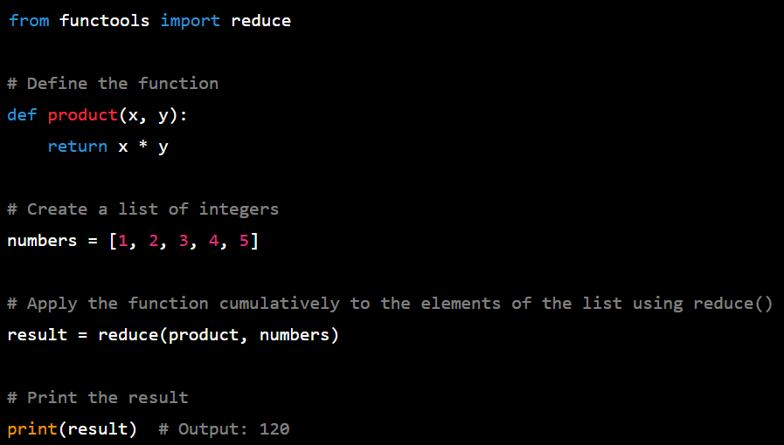
REDUCE() Example
Here's an example of using reduce() to compute the product of a list of integers:
In this example, reduce() applies the product() function cumulatively to the elements of the numbers list and returns the product of all the elements.
The functools module is used to import reduce() since it is not a built-in function in Python 3. The initial value is not provided, so the first element of the list (1) is used as the initial value

Slide 30
SORTED()
Takes an iterable as input and returns a new sorted list of the elements in the iterable. The sorted() function can be used with any iterable data type such as lists, tuples, or strings.
iterable is the iterable to be sorted.
key is an optional function that is used to determine the sorting order of each element in the iterable. If provided, the function should take an element of the iterable as input and return a value that will be used as the sorting key for that element.
reverse is an optional boolean flag that specifies whether the elements should be sorted in reverse order.

Slide 31
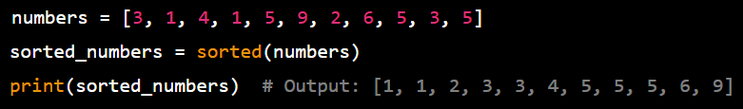
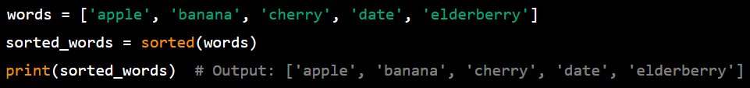
SORTED() Example
Sorting a list of numbers in ascending order:
Sorting a list of strings in alphabetical order:

Slide 32
LAMBDA FUNCTIONS

Slide 33
LAMBDA Functions
A lambda function (also called an "anonymous function" or a "function literal") is a small, one-line function that is defined without a name.
Lambda functions are often used when you need to define a simple function that you will only use once, or when you want to pass a function as an argument to another function.
Lambda functions are defined using the lambda keyword, followed by the function's arguments and a colon, and then the expression that should be evaluated and returned by the function.

Slide 34
LAMBDA Advantages
Provides a cleaner code
Performs similarly to a function
Preserves namespaces and reduces code pollution
Improve the functionalities of built-in functions and make them more expressive (expressive in programming means concisely readable and meaningful)
Fast and requires less overhead than a user-defined function
Provides a dedicated function

Slide 35
Lambda Disadvantages
Non-re-usable
Has no exact identity
Cannot include statements or multiple expressions
Can make code more difficult to debug if not used properly

Slide 36
ADDITIONAL NOTES TO USING LAMBDA
Lambda functions are limited to a single expression and cannot include statements or multiple expressions because they are designed to be used as small, anonymous functions that can be passed as arguments to other functions.
By restricting lambda functions to a single expression, they can be more concise and easier to use in these contexts.
In contrast, user-defined functions and built-in functions can include multiple statements and expressions and can have a more complex structure. This makes them more versatile and better suited to larger or more complex tasks.

Slide 37
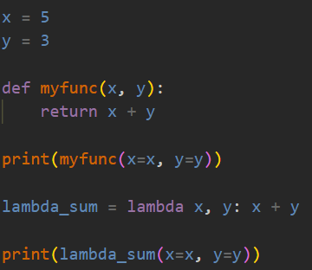
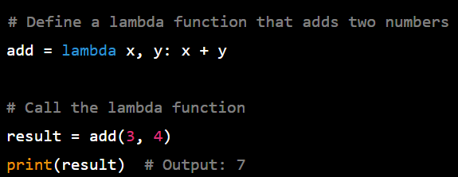

Lambda EXAMPLES
We define a lambda function called add that takes two arguments x and y and returns their sum. We can then call the lambda function and store the result in a variable result.

Slide 38
Higher-order FUNCTIONS

Slide 39
HIGHER-ORDER FUNCTIONS WITH LAMBDA
A higher-order function is a function that takes one or more functions as arguments, or that returns a function as its result.
In the context of lambda functions, a higher-order function is a function that takes one or more lambda functions as arguments, or that returns a lambda function as its result.
Higher-order functions and lambda functions can be very powerful tools for writing concise and expressive code in Python.
They allow you to create small, single-purpose functions that can be combined and reused in many different contexts, and they can help you write code that is easier to read, write, and maintain.

Slide 40
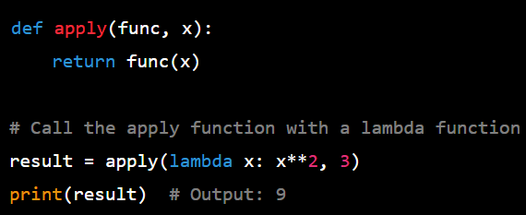
HIGHER-ORDER FUNCTIONS WITH LAMBDA
In this example, we define a higher-order function called apply that takes a function func and an argument x and applies func to x by calling func(x) and returning the result. We then call the apply function with a lambda function that squares its argument.

Slide 41
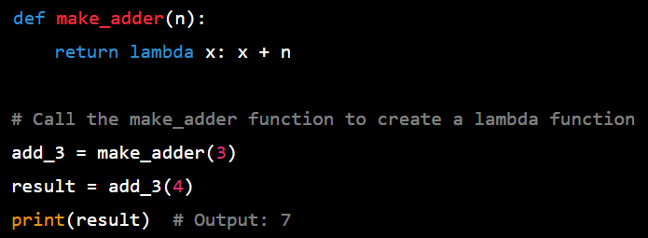
HIGHER-ORDER FUNCTIONS WITH LAMBDA
In this example, we define a higher-order function called make_adder(n) that takes an argument n and returns a lambda function that adds n to its argument. We then call the make_adder(n) function with an argument of 3, which creates a lambda function that adds 3 to its argument. Finally, we call the lambda function with an argument of 4, which returns the result of 4 + 3 = 7.

Slide 42
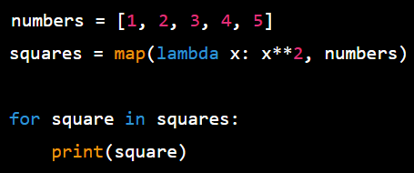

HIGHER-ORDER FUNCTIONS USING BUilT-IN FUNCTIONS AND LAMBDA
The map() function is a built-in higher-order function in Python that applies a function to each element of an iterable and returns a new iterable of the results.
Here's an example of using map() with a lambda expression to compute the square of each number in a list:

Slide 43
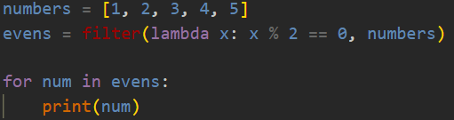

HIGHER-ORDER FUNCTIONS USING BUilT-IN FUNCTIONS AND LAMBDA
The filter() function is another built-in higher-order function in Python that takes a function and an iterable as input and returns a new iterable containing only the elements of the original iterable for which the function returns True.
Here's an example of using filter() with a lambda expression to filter a list of numbers to only include the even ones:

Slide 44
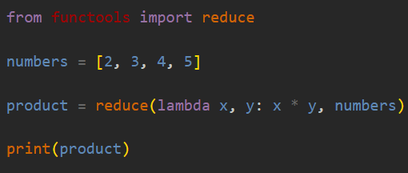

HIGHER-ORDER FUNCTIONS USING BUilT-IN FUNCTIONS AND LAMBDA
In this example, the reduce() function is used to apply the lambda function to the list of numbers, producing a single result. The lambda function takes two arguments, x and y, and returns their product (x * y). The reduce() function starts by multiplying the first two numbers in the list (2 * 3 = 6), and then applies the lambda function to the result and the next number in the list (6 * 4 = 24, 24 * 5 = 120). The result (120) is then assigned to the variable product, which is printed to the console.
Here's an example of how you might print the results of the computation to the console:

Slide 45
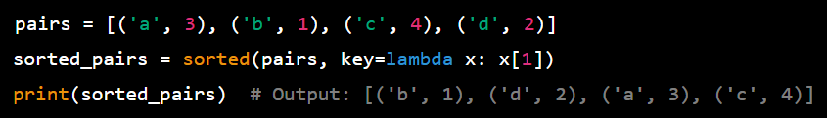
HIGHER-ORDER FUNCTIONS USING BUilT-IN FUNCTIONS AND LAMBDA
In this example, the key argument is set to a lambda function that returns the second element of each tuple, which is used to determine the sorting order of the tuples.
Note that sorted() returns a new sorted list and does not modify the original iterable.

Slide 46
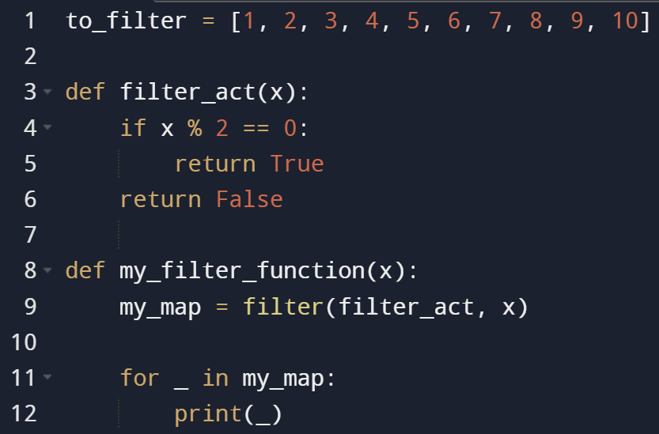
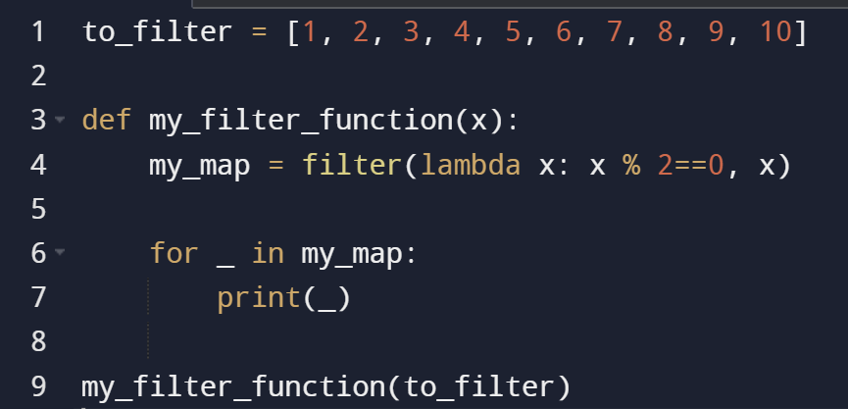
Why is it better to use lambda with higher-order built-in functions sometimes
It does not consume additional namespace for just a simple and very specific task
Lessen the number of lines

Slide 47
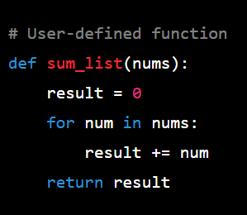
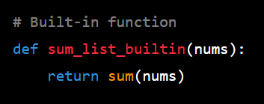
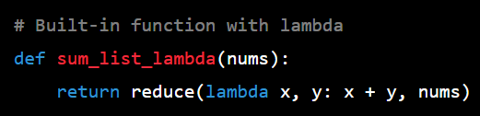
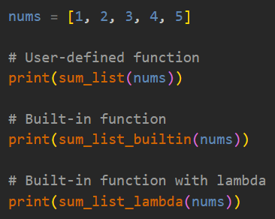
COMPARISONS

Slide 48

More examples
To access more examples with explanations, you may visit this link.
https://github.com/francismontalbo/learning_python

